Slide 1
Skills for Study student guide – Email domain access
www.skillsforstudy.com

Slide 2
About email domain access
What you need to know:
Email domain access allows users to create an individual Username/Password account.
Users must use their institution email as their username.
The email address must match an email domain specified by the institution.
Users of this access method are required to login each time to gain access.
This works on or off campus.

Slide 3
How to use Skills for Study
Head to skillsforstudy.com and click the white ‘Student log in’ button in the top right of the homepage

Slide 4
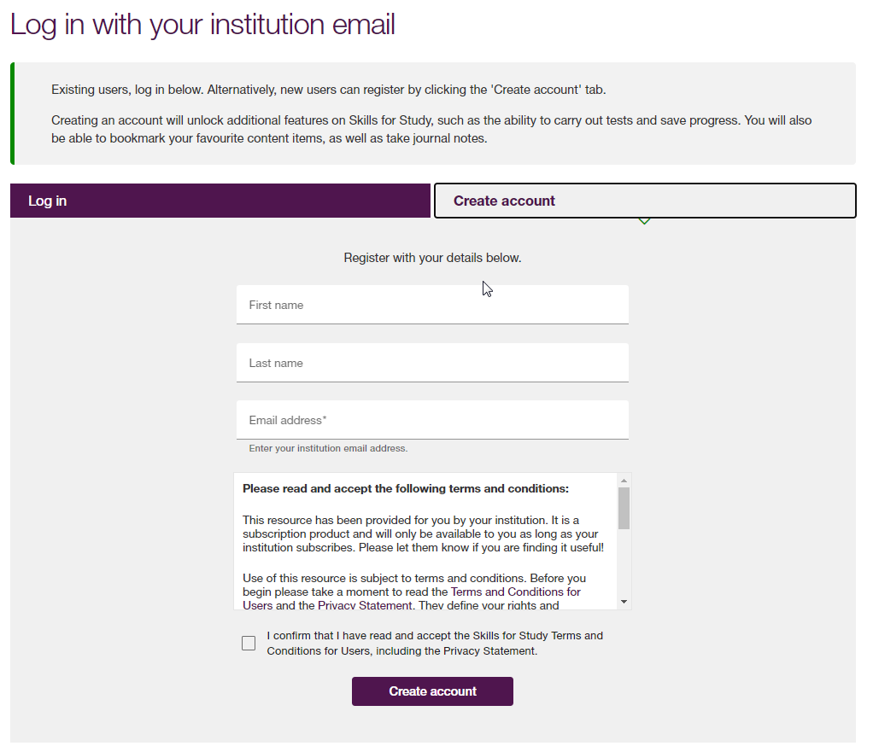
How to use Skills for Study
To access the content, you will need to login (if you have previously created an account) or create an account using your College/University email address.
You will receive an email to the email address you entered at the account creation stage.
Click the link in the email to set your Skills for Study password.
You will be automatically logged in and directed to the student homepage.

Slide 5
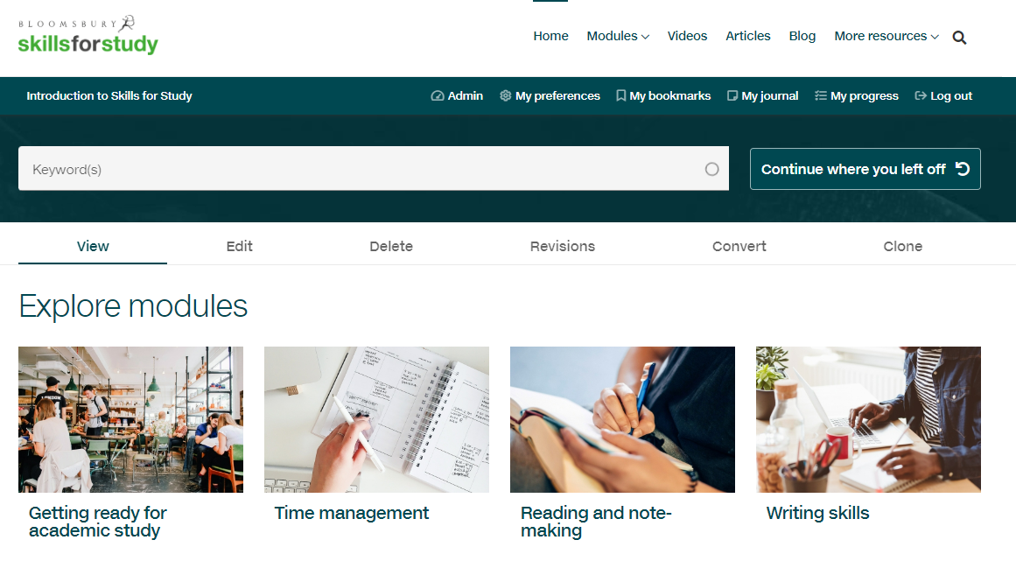
How to use Skills for Study
Once at the Skills for Study student homepage, browse the skills you can work on, or choose from the ‘modules’ dropdown.

Slide 6
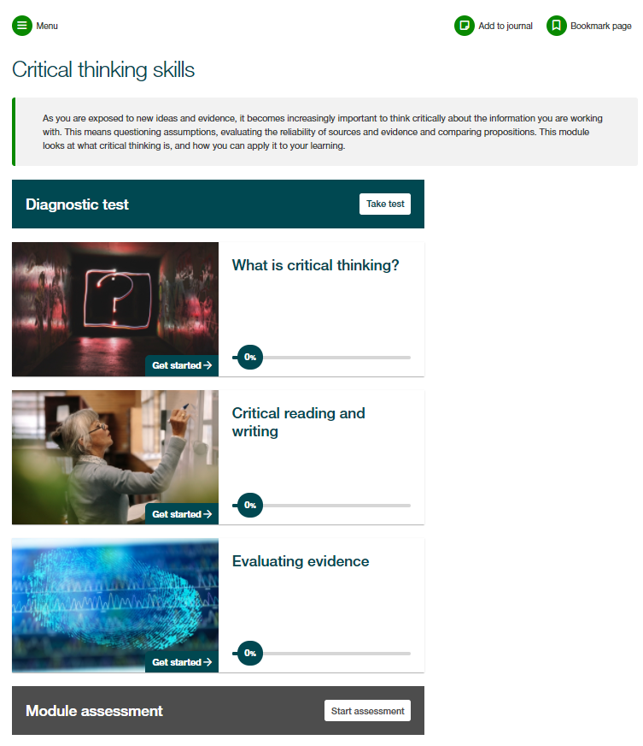
How to use Skills for Study
Each module is structured in the same way, with a module introduction, diagnostic test, sections of content and then a module assessment.
We would always recommend that you complete the diagnostic test first; this will help you to identify your strengths and areas for development so that you can prioritise your time.

Slide 7
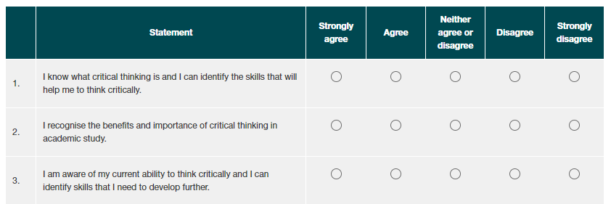
How to use Skills for Study
Complete the survey to see your personalised recommendations.
Red shows content which is highly recommended
Gold shows content which would be useful
Green shows content which is worth a look
You can then click on the section name to go straight through to the activities and start developing your study skills!

Slide 8
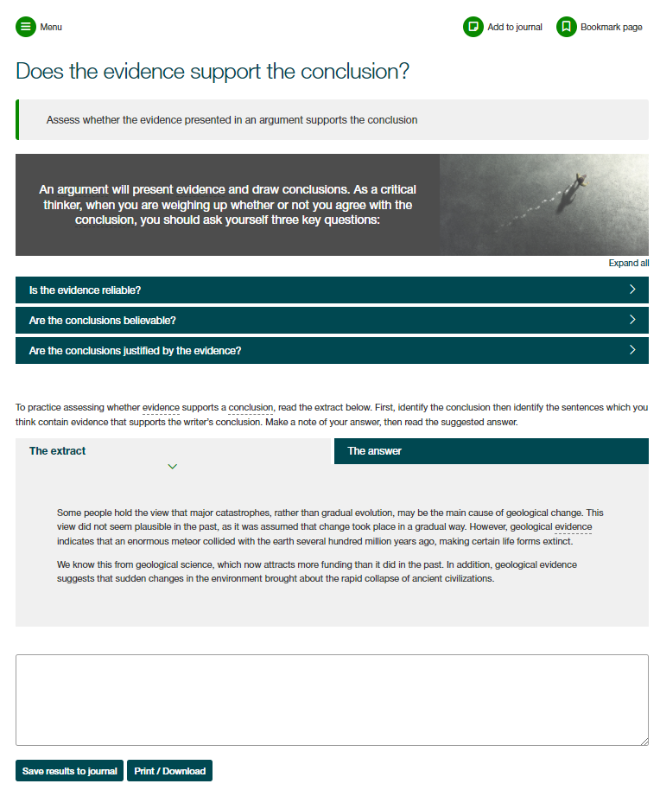
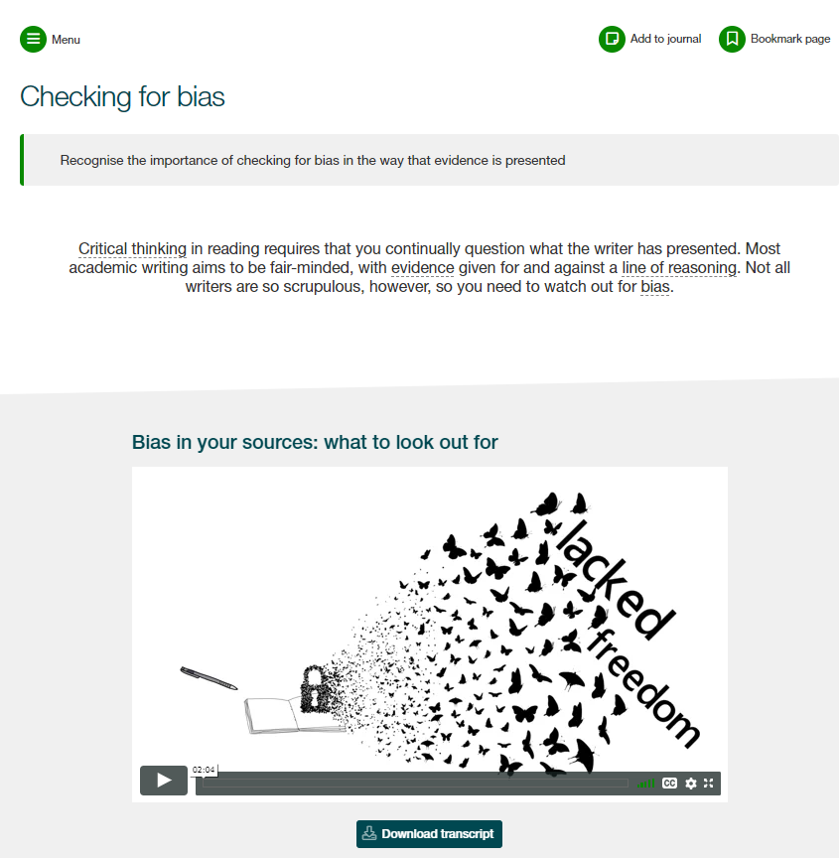
How to use Skills for Study
Work through the engaging activities and practice exercises to build your skills.
Save notes and personal reflections in your journal as you go and bookmark pages to come back to them later

Slide 9
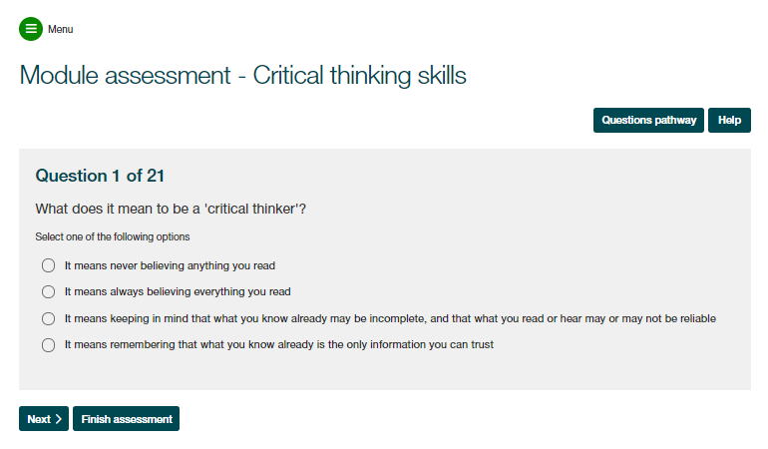
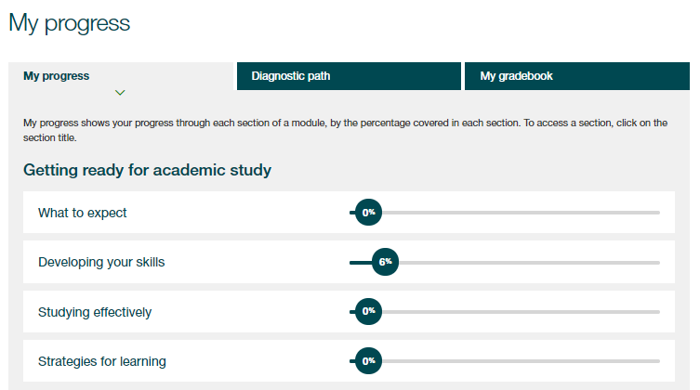
How to use Skills for Study
At the end of the module you’ll find your module assessment, which will help you put what you’ve learnt into practice and check if you’ve absorbed all the information.
Use the ‘My Progress’ section to review your completion of activities and track your assessment scores

Slide 10
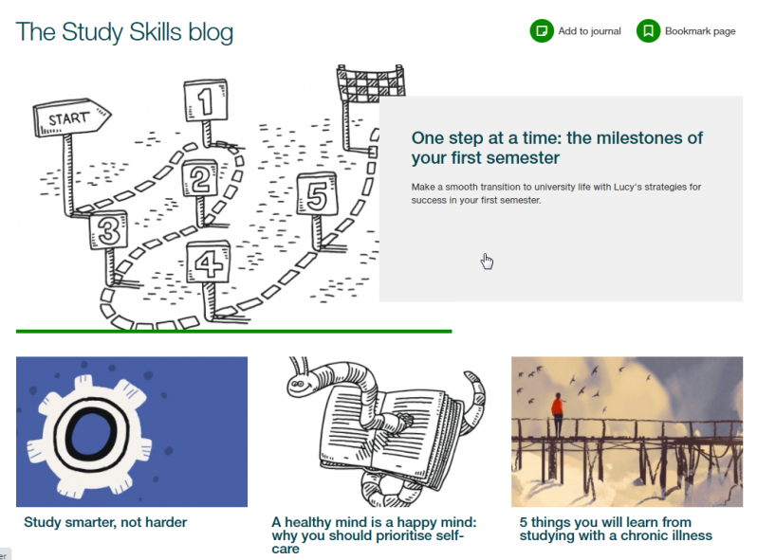
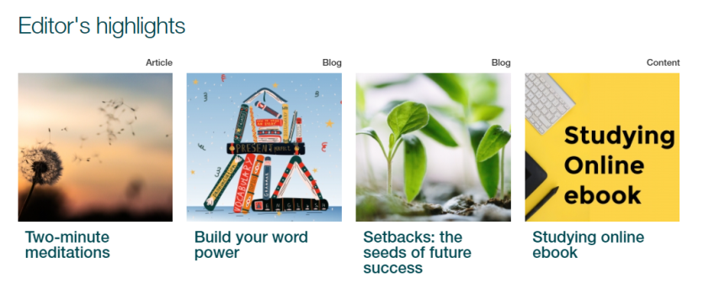
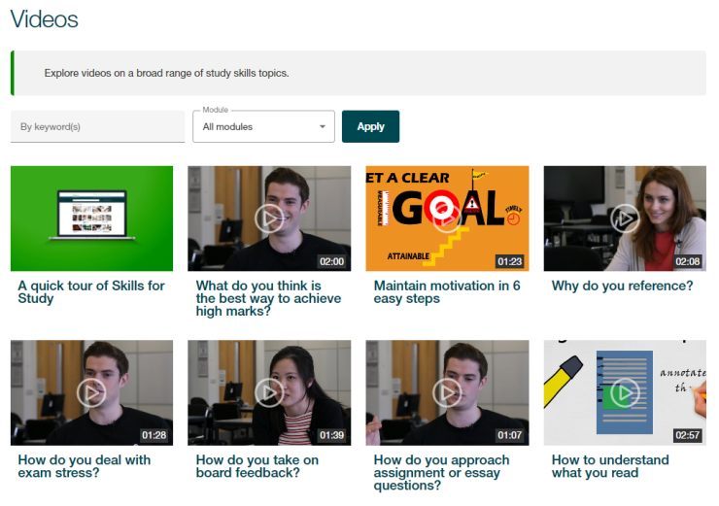
How to use Skills for Study
Explore the Editor’s Highlights, videos, blog and articles for bitesized content to boost your learning

