Slide 1
Skills for Study student guide – Single Sign On access
www.skillsforstudy.com

Slide 2
About Single Sign On access
What you need to know:
Single Sign On allows users to access the resource using their current college/university account details.
They are required to register (one time only) with their institution email but do not have to create an additional username and password.
This access method grants access to users both on and off campus.

Slide 3
How to access Skills for Study
1. Head to skillsforstudy.com. Click the white ‘Student log in’ in the top right of the screen.

Slide 4
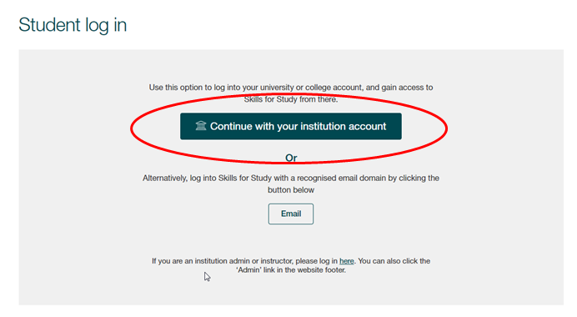
How to access Skills for Study
2. Click on the green ‘Continue with your institution account’ button

Slide 5
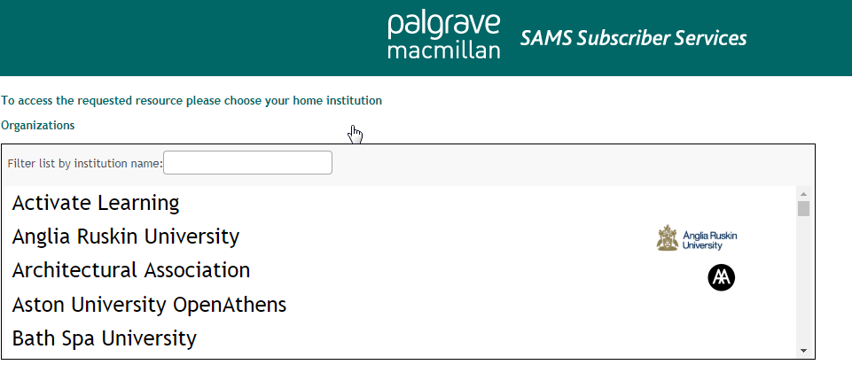
How to access Skills for Study
3. Search for your College or University and select it from the list
4. You will then be re-directed to your college/university login. Login with your College or University credentials

Slide 6
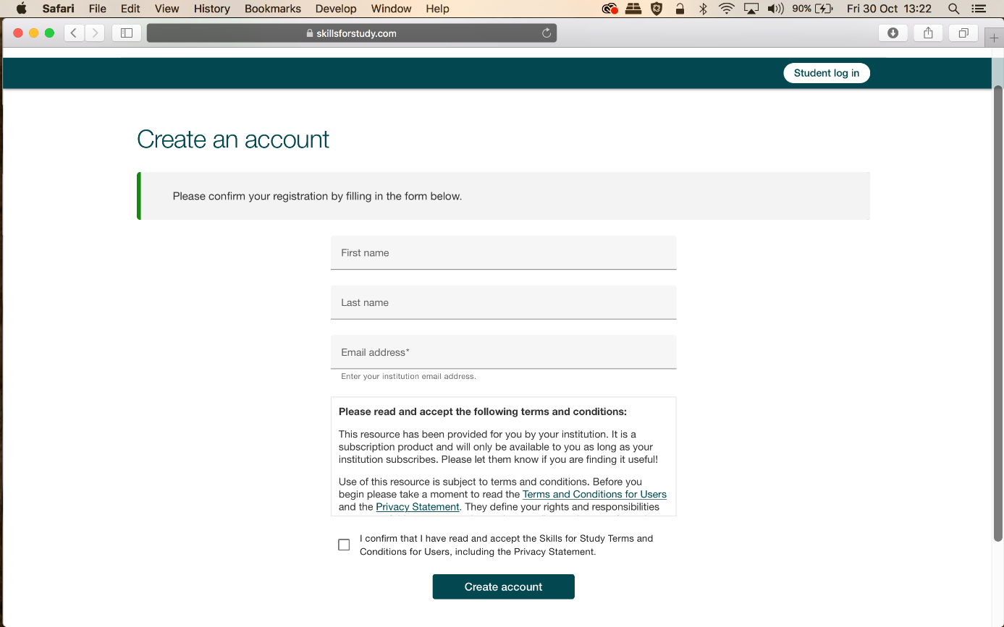
How to access Skills for Study
5. Enter your first name, last name and College or University email address to confirm your registration

Slide 7
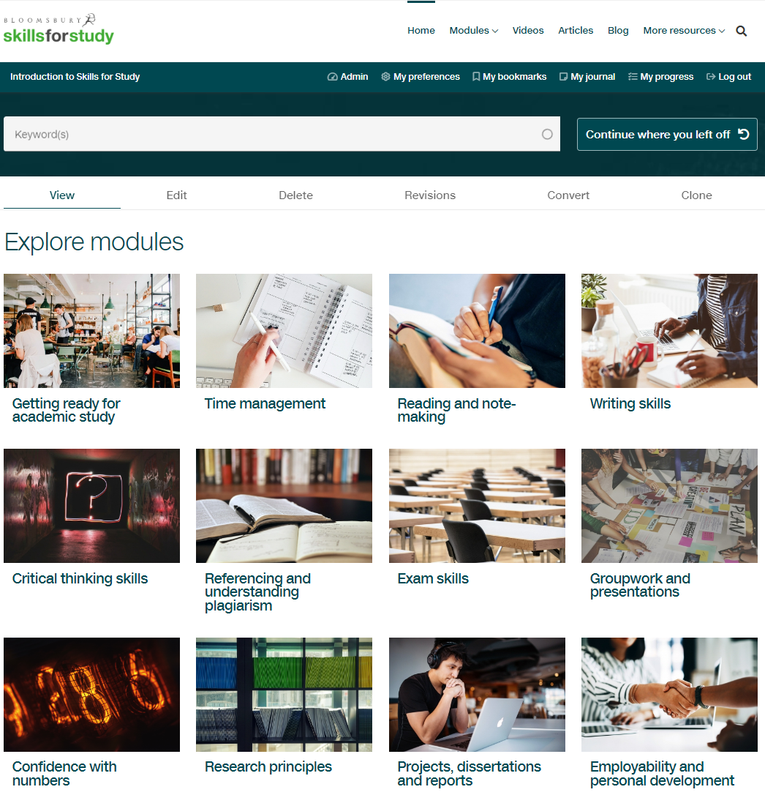
How to use Skills for Study
Once at the Skills for Study student homepage, browse the skills you can work on, or choose from the ‘modules’ dropdown.

Slide 8
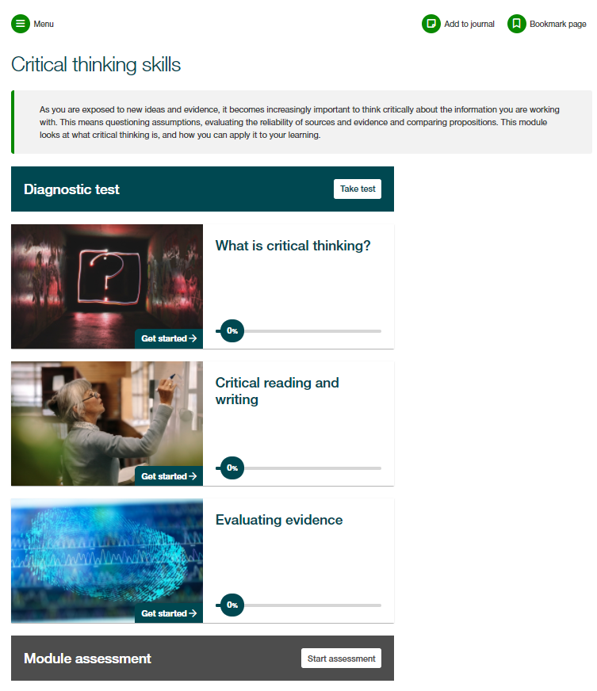
How to use Skills for Study
Each module is structured in the same way, with a module introduction, diagnostic test, sections of content and then a module assessment.
We would always recommend that you complete the diagnostic test first; this will help you to identify your strengths and areas for development so that you can prioritise your time.

Slide 9
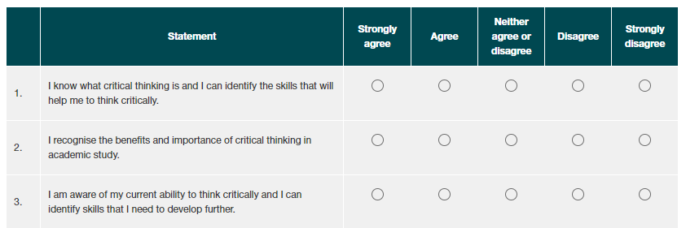
How to use Skills for Study
Complete the survey to see your personalised recommendations.
Red shows content which is highly recommended
Gold shows content which would be useful
Green shows content which is worth a look
You can then click on the section name to go straight through to the activities and start developing your study skills!

Slide 10
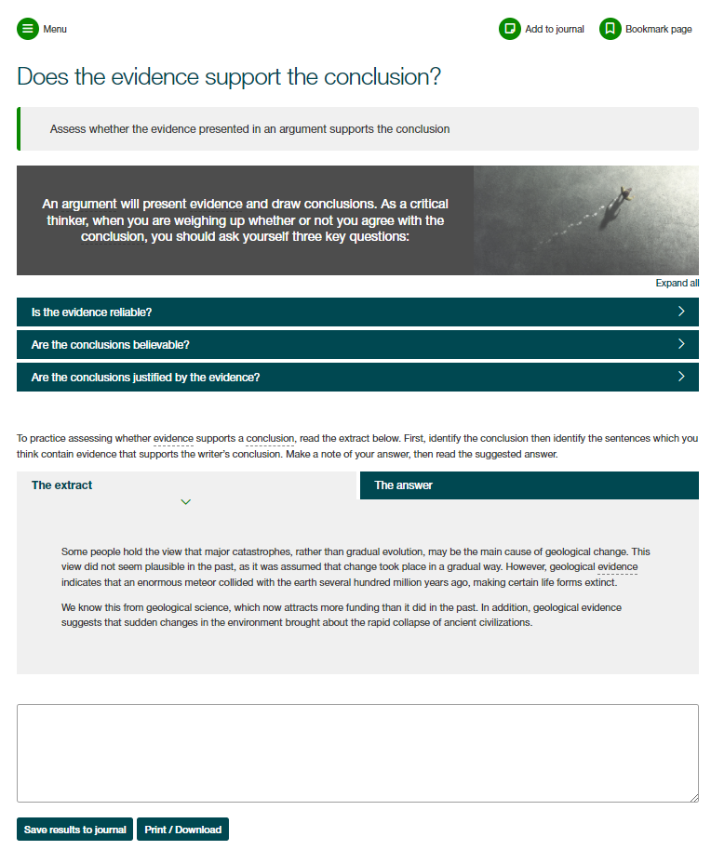
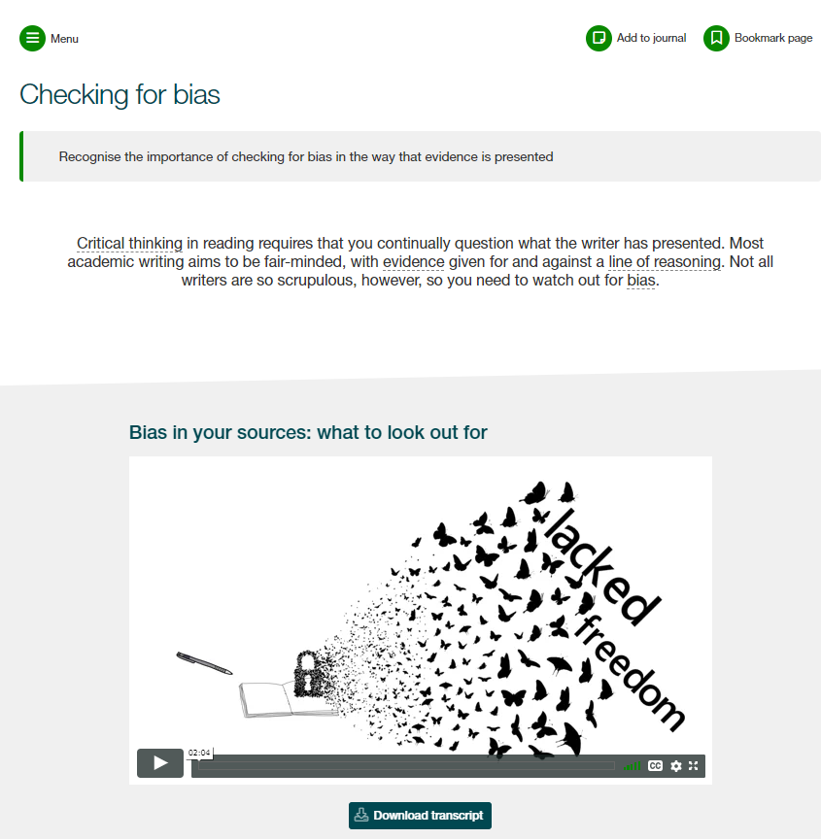
How to use Skills for Study
Work through the engaging activities and practice exercises to build your skills.
Save notes and personal reflections in your journal as you go and bookmark pages to come back to them later

Slide 11
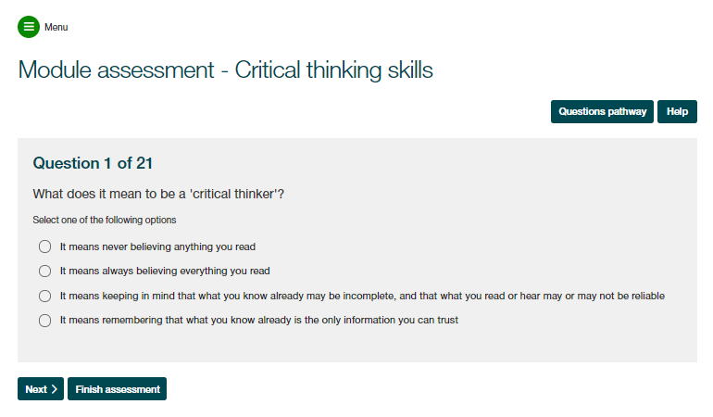
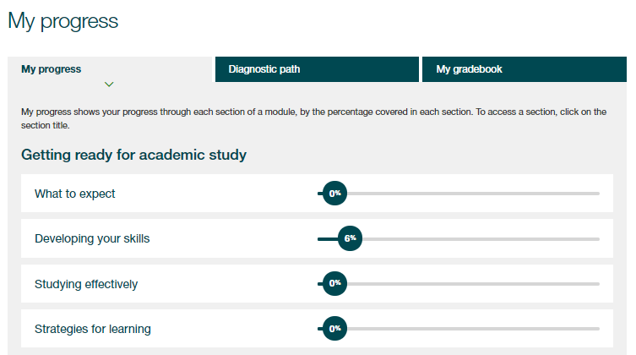
How to use Skills for Study
At the end of the module you’ll find your module assessment, which will help you put what you’ve learnt into practice and check if you’ve absorbed all the information.
Use the ‘My Progress’ section to review your completion of activities and track your assessment scores

Slide 12
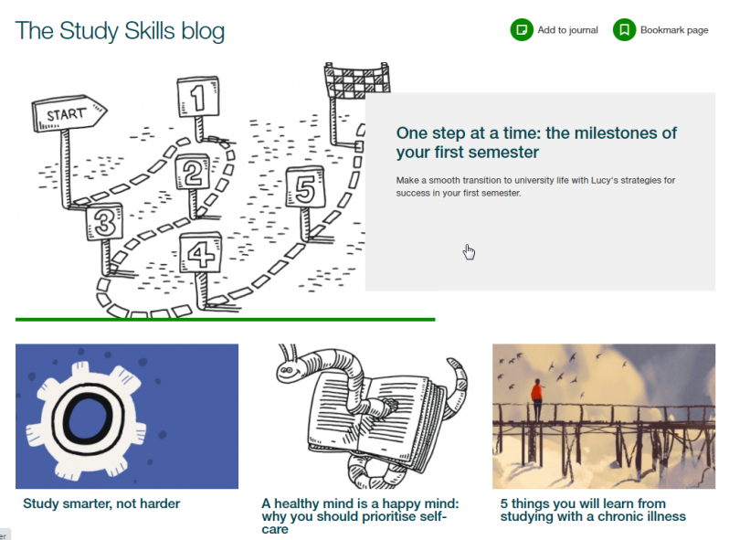
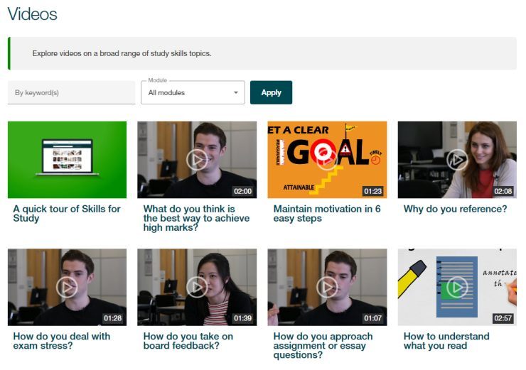
How to use Skills for Study
Explore the Editor’s Highlights, videos, blog and articles for bitesized content to boost your learning

